Slide 1
Movie Performance Analysis and Recommendations for Microsoft
Phase 1 Project Findings, by Leonard Koyio

Slide 2
Introduction: Business Understanding
-Microsoft aims to enter the movie production industry and would like recommendations on how best to enter into the market
-Objective: Analyze existing film data to discover trends and patterns for box office success

Slide 3
Key Business Questions
Which genres perform best?
What is the optimal runtime for movies?
How does release timing impact performance?
What is the correlation between financial performance metrics?

Slide 4
Data Understanding
Objective: Use information about movies and their performance in the industry to determine which metrics and trends achieve great success in the market. Based on the trends, give Microsoft a concrete recommendation on how best to penetrate the market.
-Focus on info on genre, runtime, release timing of movies and how they affect and relate to the audience ratings, popularity , and ultimately financial success of the movies in the industry.

Slide 5
Methodology
Data Collection: Multiple datasets on movies.
Data Cleaning: Removed duplicates and irrelevant data.
Data Analysis: Statistical analysis and visualization.
Conclusion: Give Microsoft concrete recommendations based on findings on analysis

Slide 6
Analysis: Optimal Runtime
120+ minutes: Best performance across all metrics.
140-160 minutes: Highest gross.
160+ minutes: Best ROI.
<100 minutes: Generally poor performance, especially 60-80 minutes.

Slide 7
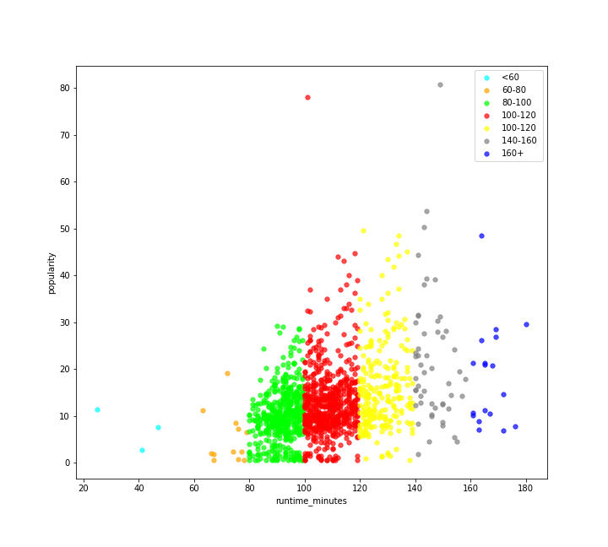
Data visualisation
Scatter plot showing positive correlation between runtime of movies and popularity

Slide 8
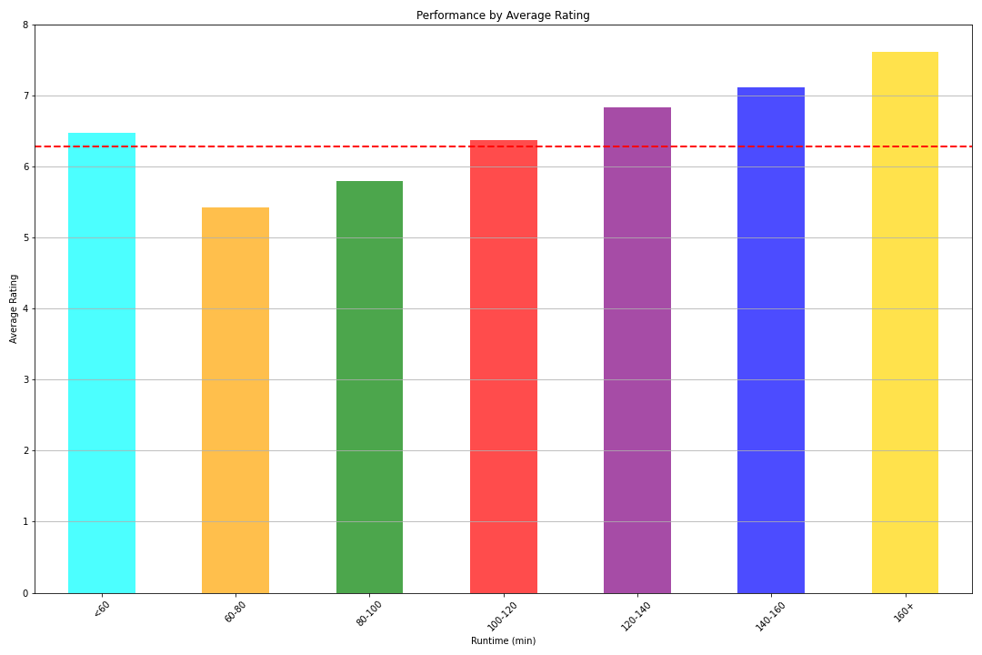
Bar graph showing relationship between runtime and audience reception

Slide 9
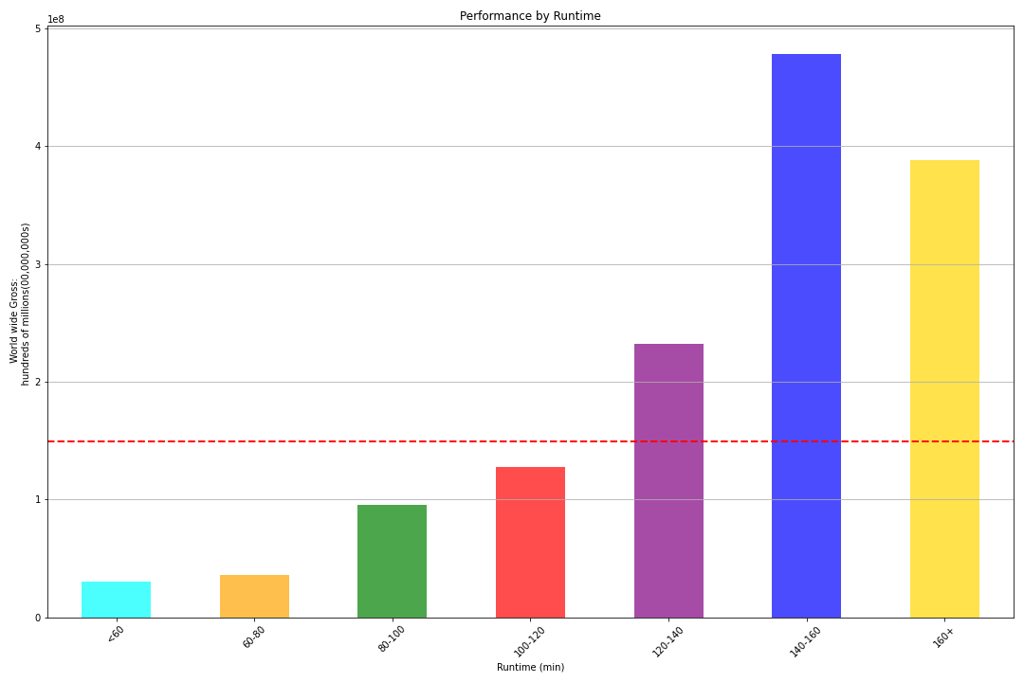
Bar graph showing positive relationship between runtime and worldwide gross

Slide 10
Analysis: Release Timing
Best Months: May, June, December (Winter and Summer in Northern Hemisphere)
Worst Months: February, August, September.
Implications: Timing significantly affects box office success and audience reception.

Slide 11
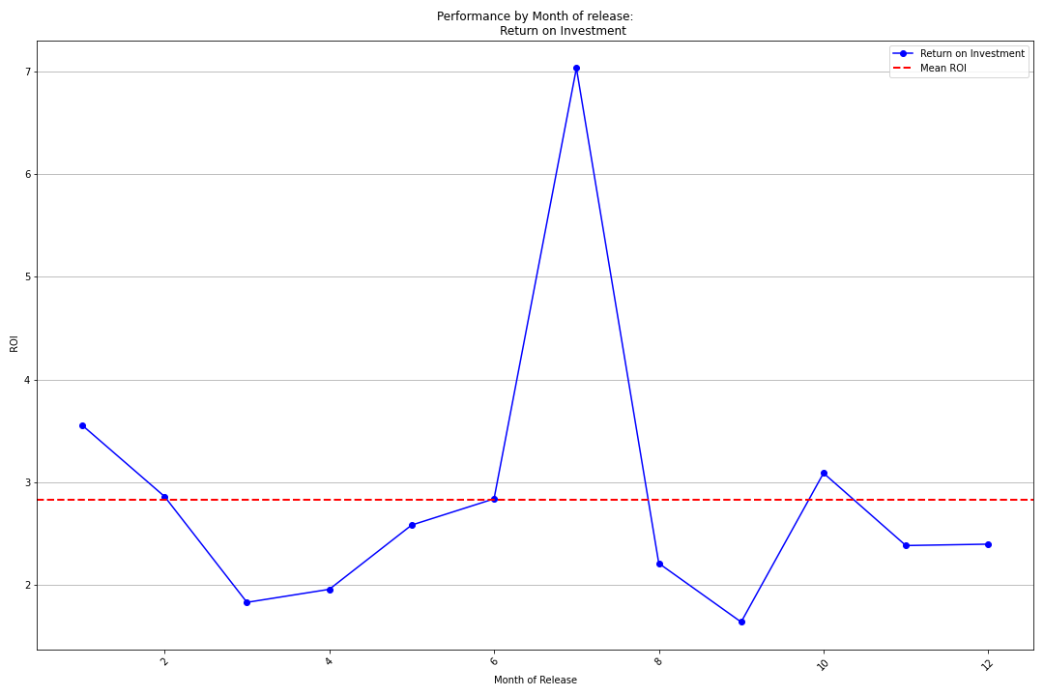
Data Visualization
Line graph showing Return on Investment by Month of Release. A distinct peak can be seen in June.

Slide 12
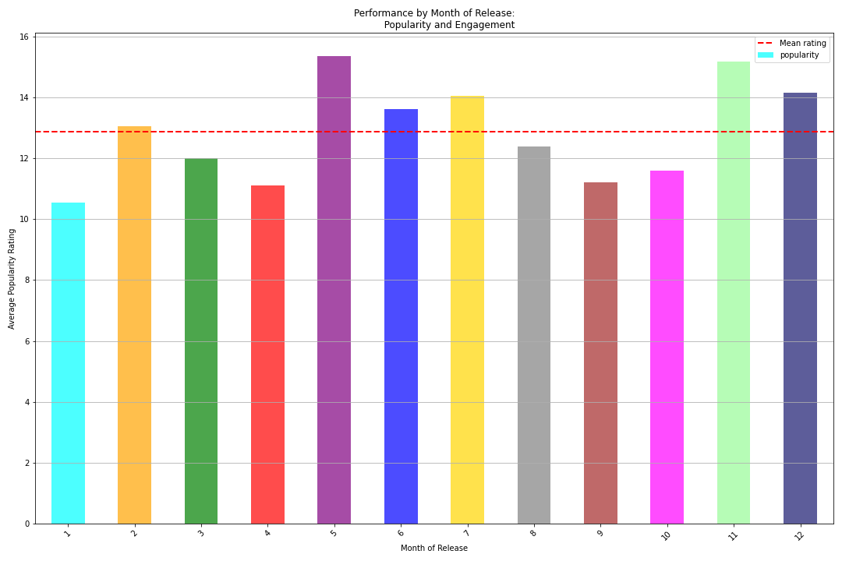
Bar graph showing popularity of movies based on month of release. Distinct peaks are seen in May and November while troughs are seen in April and September

Slide 13
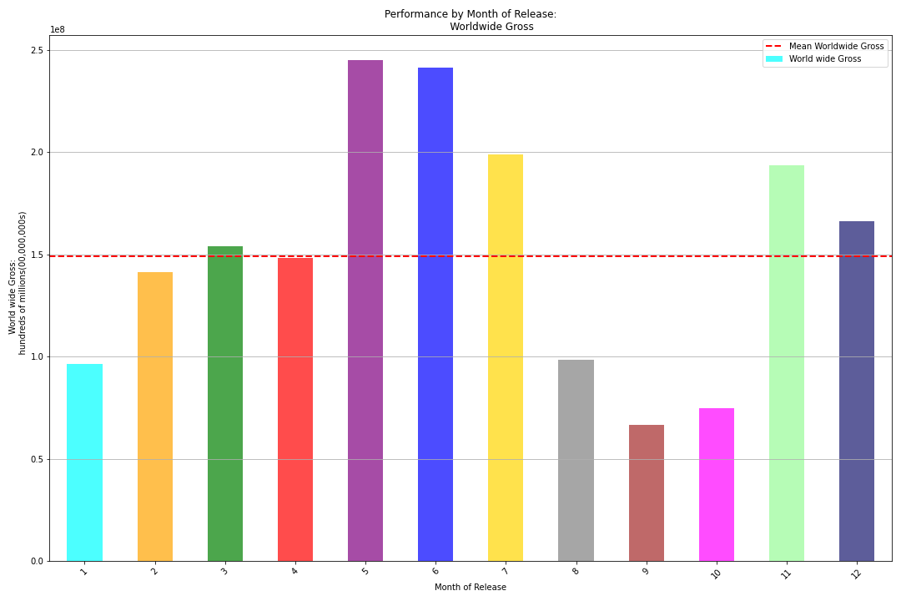
Bar graph showing worldwide gross of movies based on month of release. Distinct peaks are seen around May and November.

Slide 14
Analysis: Genre Performance
Top Genres: Adventure, Animation, Sci-Fi, Fantasy, Action.
High Ratings but Lower Gross: Documentary, Biography, History, Music.
Poor Performers: Adult, News, Reality-TV.

Slide 15
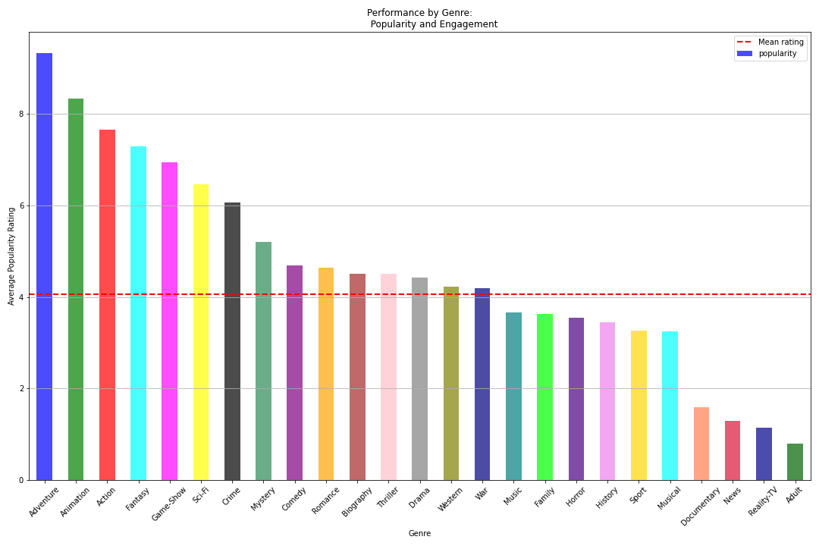
Data visualisation
Bar graph showing popularity of movies based on genre.
Top performers- Adventure, Animation, Action
Poor performers- Adult, Reality TV, News

Slide 16
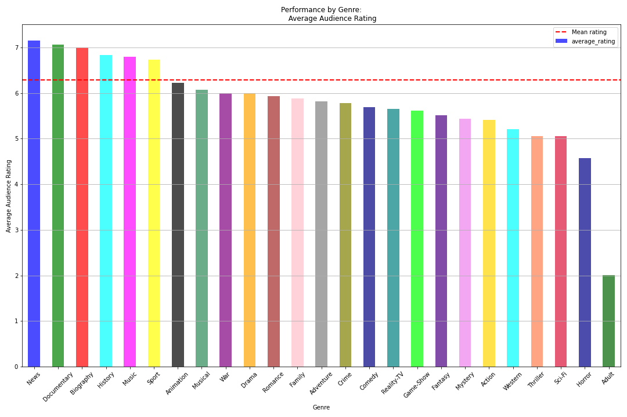
Bar graph showing audience reception of movies based on genre.
Top performers- News, Documentary, Biography, History
Poor performers- Adult, Horror, Thriller

Slide 17
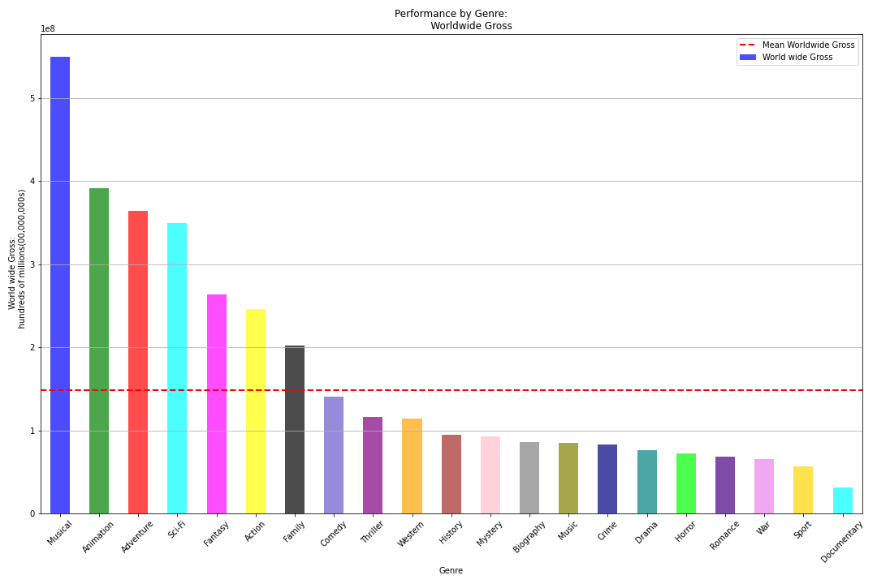
Bar graph showing world wide gross of movies based on genre.
Top performers- Musical, Animation, Adventure, Sci-fi
Poor performers- Documentary, Sport, War

Slide 18
Recommendations for Microsoft
Focus on Optimal Runtimes: 120+ minutes, especially 140-160 minutes.
Strategic Release Timing: May, June, December. Avoid February, August, September.
Invest in High-Performing Genres: Adventure, Animation, Sci-Fi, Fantasy, Action.
Avoid Low-Performing Genres: Adult, News, Reality-TV.

Slide 19
Conclusion
Microsoft has the opportunity to strategically enter the movie production industry by leveraging data-driven insights.
By focusing on optimal runtimes, strategic release timing, and investing in high-performing genres, Microsoft can maximize both financial returns and audience engagement.
Avoiding low-performing genres and release periods will minimize risks and enhance overall performance.
Implementing these recommendations can position Microsoft as a competitive and successful player in the film industry, ensuring a balance of box office success and audience satisfaction.

